Slide 1
Auto Attendance System
IT314 Project
Group 6

Slide 2
Group Members and Contributions
Meshv (202001006) (Group Leader) | Student Back-end
Rhythm (202001001) | Email sending,Upload file and Download report
Praneet (202001004) | Login page (Instructor and Student), Dashboard and CoursePage(Instructor) Attendance Credentials (half) Demo Video
Vatsal (202001027) | Create Course, Add student, Lecture page Open Attendance, 404 page, GUI Testing Unit Testing and Debugging System Testing and Maintenance Non-Functional Testing
Poojan Patel (202001028) | Instructor Back-end and Slides
Dev Malkan (202001040) | Homepage, Attendance Credentials(half) Register (student & instructor) Dashboard and CoursePage (Student)
All | SRS and Design Documents

Slide 3
Objectives
Reliable and efficient way of taking attendance
Time saving.
Improves data security and simplifies attendance record keeping.
Effortless and accurate attendance statistics.
An effort to make the whole attendance system smart.

Slide 4
Milestones
Brainstorming
Requirements Gathering
Validating the expectations
Pre-development planning
Choosing a software process model
Building a Use-Case Model
Checking for Non-functional requirements
Selecting appropriate Frameworks and Databases for development
Estimation of efforts and anticipating man-hours
Designing and Implementing the system
Testing the system at different levels and making needed changes

Slide 5
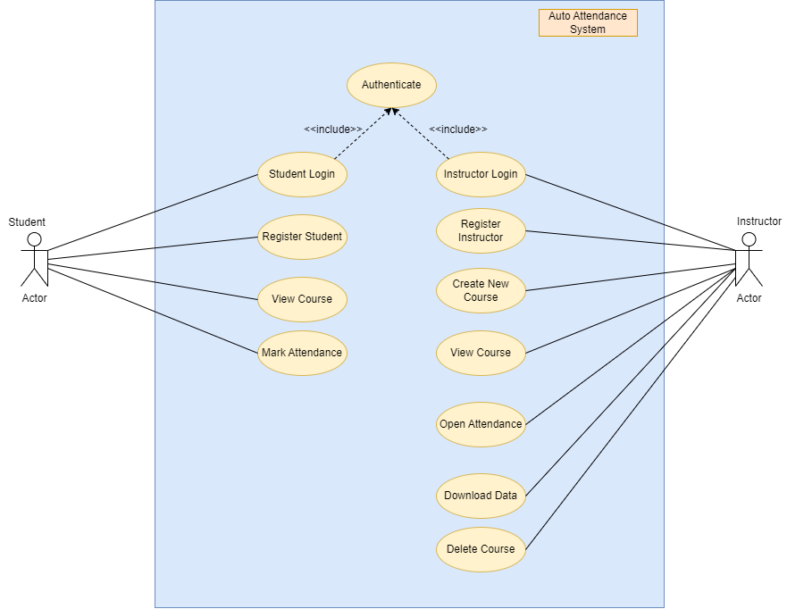
Use-Case Diagram

Slide 6
Takeaways from this project
Gather proper requirements from appropriate users.
Project planning and designing is important.
Selecting the appropriate frameworks for the full stack project.
Picking correct attributes for database is more important than picking the right kind of database.
Testing phase may seem more difficult than the development phase.
Retesting the module/unit after fixing/debugging or adding new functionality is very important.
An idea without deliverable implementation is useless.

Slide 7
Achievements
Our AutoAttendanceSystem is reliable and accurate.
Serves the purpose of automation in attendance management and saves time.
Visualization of statistics is very readable and responsive for different screen sizes.
Automated email sending successfully working.

Slide 8
Mistakes
We used rendering of ejs after authentication instead of using API, which later proved to be a mistake while testing the units.
Not that scalable and not the best performance.
Not able to implement a perfect authentication.
Didn’t use the ‘Forgot Password’ feature.

Slide 9
Rating the software artifacts
Factor No. | Factor Name | Rating (on 1 to 5)
1 | Accuracy | 4.5
2 | Efficiency | 3
3 | Usability | 4
4 | Scalability | 3
5 | Security | 3.5
Overall Rating |  | 3.6

Slide 10
Overall Rating of AAS
No. | Factor | Rating (0 to 1)
1 | Security | 0.7
2 | Compatibility | 0.9
3 | Portability | 0.9
4 | Reliability | 0.5
5 | Scalability | 0.5
6 | Performance | 0.5
7 | Localisation | 0.9
8 | User-Friendly | 0.8
9 | Data Security | 0.8
10 | Visibility | 0.9
Overall Rating |  | 7.4

Slide 11
Thank you!
Professor Saurabh Tiwari
Professor Manish Khare
And respective TA/s

